Slide 1
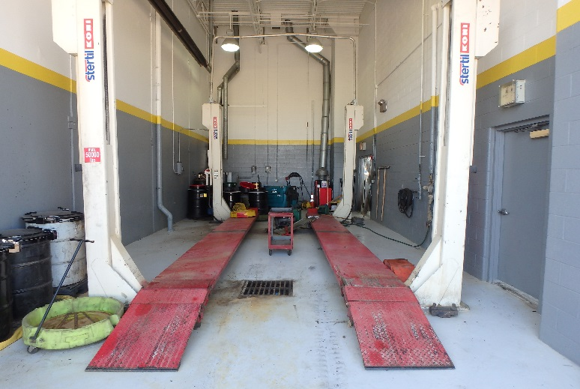
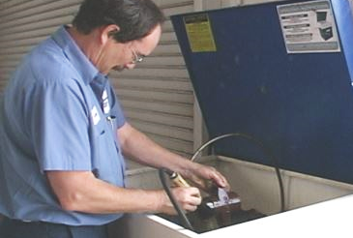
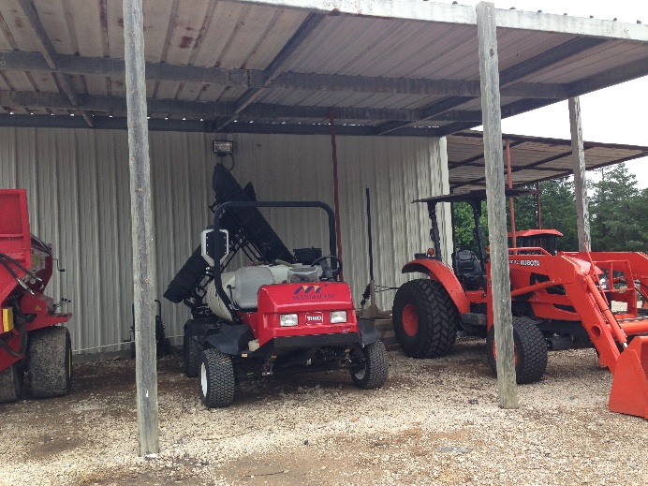
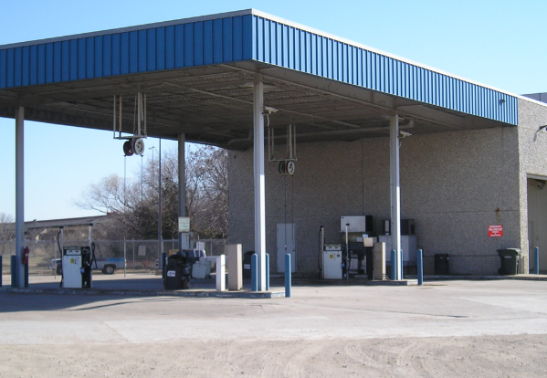

DO YOUR PART—KEEP POLLUTION OUT OF STORM DRAINS & WATERWAYS
FLEET MAINTENANCE
Vehicle & Equipment Maintenance/Cleaning
Parts Cleaning
Leaking Vehicles
Fueling
Perform maintenance
and cleaning in
designated areas.
Wash parts in designated cleaning stations.
Make sure parts fully drain before removing them.
Park leaking vehicles
under cover.
Use a drip pan or absorbents for collection.
Inspect fueling areas often, and clean as needed.
Don’t top off the fuel tank!
Know the locations of the emergency shut-off button and spill kit.
REPORT POLLUTION & ILLEGAL DUMPING
[City Logo]
Be our eyes—look for and report signs of water pollution.
Signs include odor, an oily sheen on the water’s surface, colored or cloudy water, dead or dying fish, and excess trash.
Report spills and issues to [Contact Department, Phone Number].
Created in partnership with the Regional Stormwater Management Program.

Slide 2
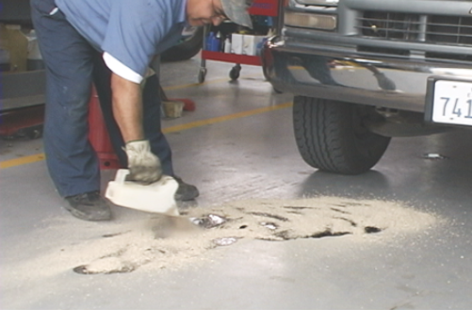
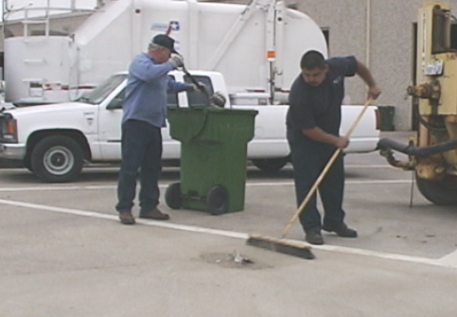
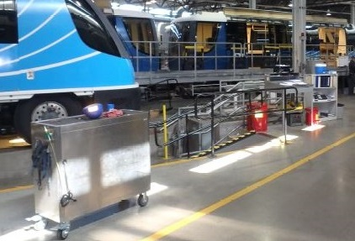
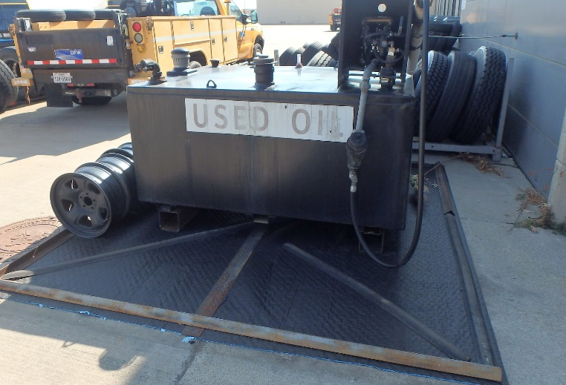
DO YOUR PART—KEEP POLLUTION OUT OF STORM DRAINS & WATERWAYS
FLEET MAINTENANCE
Spills
Cleaning Outside
Work Areas
Cleaning Shop
Used Fluid, Filter, & Battery Disposal
Clean up spills immediately.
Use a drip pan or absorbents for collection.
Place spent absorbents into appropriately labeled disposal containers.
Clean regularly. Take extra precaution if rain is forecast.
Use dry methods such as sweeping—don’t hose down the work area.
Make sure that trash receptacles are emptied as needed.
Use dry methods for cleaning when possible.
Dispose of mop water properly. It should go
into the sanitary sewer system.
Promptly dispose
of waste.
Store items under cover or in secondary containment.
Store used fluids in labeled containers.
Recycle or properly dispose of used fluids, hydraulic filters, and batteries.
REPORT POLLUTION & ILLEGAL DUMPING
[City Logo]
Be our eyes—look for and report signs of water pollution.
Signs include odor, an oily sheen on the water’s surface, colored or cloudy water, dead or dying fish, and excess trash.
Report spills and issues to [Contact Department, Phone Number].
Created in partnership with the Regional Stormwater Management Program.

Slide 3
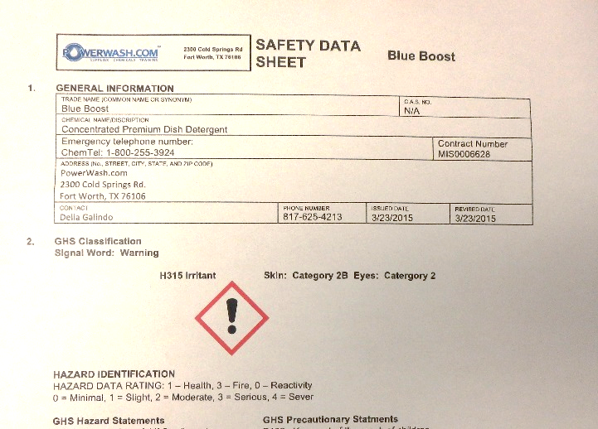
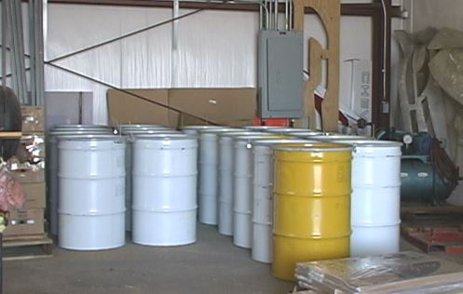
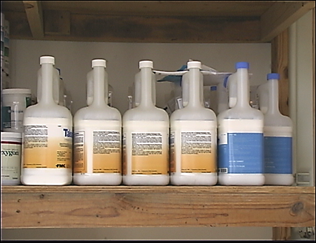
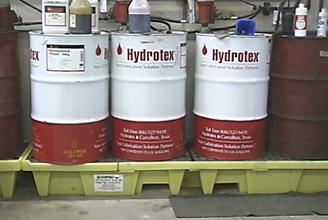
DO YOUR PART—KEEP POLLUTION OUT OF STORM DRAINS & WATERWAYS
MATERIALS STORAGE
Instructions
& Procedures
Safe Materials
Storage
Containers
Spill-Trapping
Devices
Follow label or safety data sheet (SDS) instructions and established procedures.
Contact supervisors with questions.
Store materials away from high-traffic areas (ideally, indoors in sealed containers).
Use original or clearly labeled replacement containers.
Keep containers closed or sealed when not in use.
Inspect containers regularly.
Replace any damaged containers.
Store materials on a spill containment base.
Border storage areas
with a curb, berm, or similar method.
REPORT POLLUTION & ILLEGAL DUMPING
[City Logo]
Be our eyes—look for and report signs of water pollution.
Signs include odor, an oily sheen on the water’s surface, colored or cloudy water, dead or dying fish, and excess trash.
Report spills and issues to [Contact Department, Phone Number].
Created in partnership with the Regional Stormwater Management Program.

Slide 4
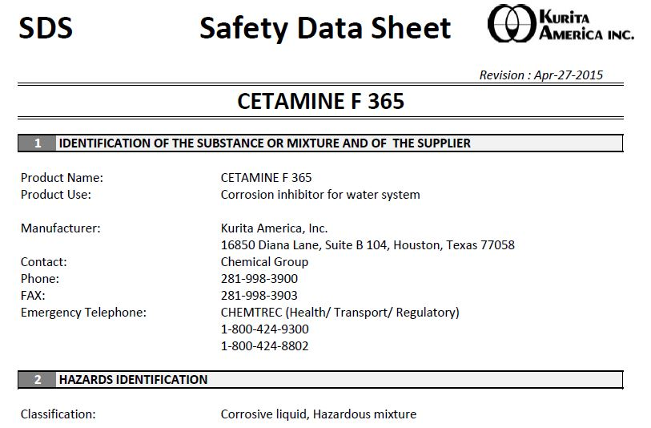
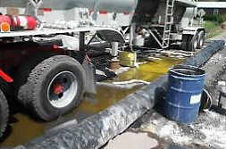
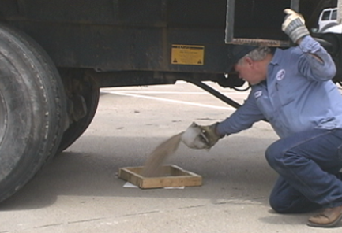
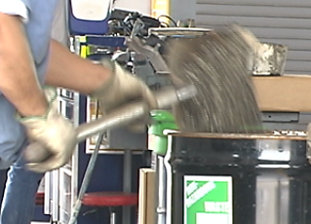
DO YOUR PART—KEEP POLLUTION OUT OF STORM DRAINS & WATERWAYS
SPILLS
Instructions
& Procedures
Containment
Cleanup
Disposal
Follow cleanup instructions specified on the label or safety data sheet (SDS) and established procedures.
Contact supervisors with questions.
Isolate and stop the leak
if possible.
Collect liquid spills with a drip pan or absorbents.
Protect inlets if spills may enter a storm drain.
Cover a powder spill with plastic sheeting to keep it from spreading.
Immediately clean up nonhazardous spills.
—For liquid spills: Use absorbents.
—For all spills: Don’t hose down the spill.
Notify proper personnel to clean up hazardous spills.
If spilled dry material is usable, put it in the original or properly marked container.
Otherwise, follow proper disposal procedures.
report large or hazardous spills
[City Logo]
Immediately report large or hazardous spills to your supervisor or environmental department staff.
[Contact Department, Phone Number]
Created in partnership with the Regional Stormwater Management Program.

Slide 5
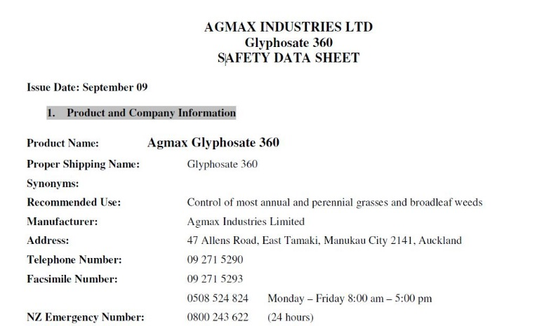
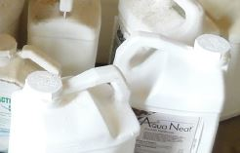
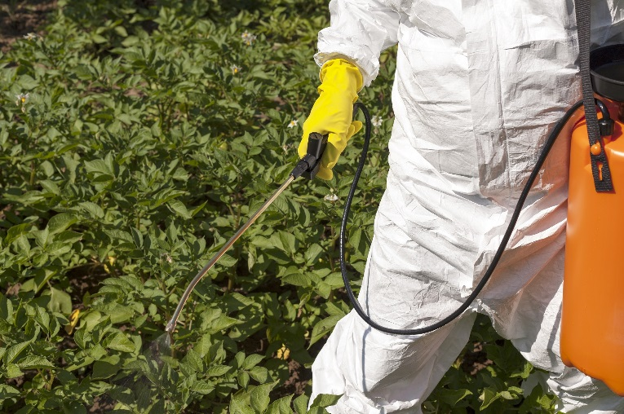
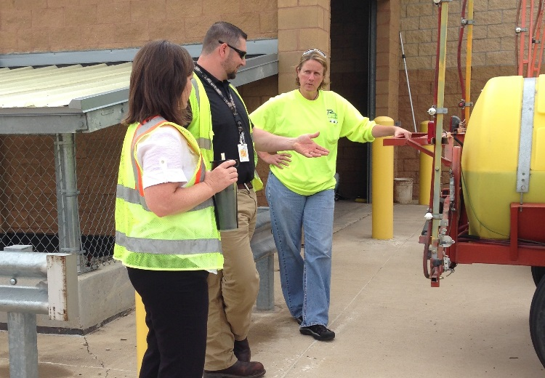
DO YOUR PART—KEEP POLLUTION OUT OF STORM DRAINS & WATERWAYS
PARKS & Ground Maintenance: CHEMICALS
Instructions
& Procedures
Choosing the
Right Product
Mixing & Applying
Chemicals
Leaks & Spills
Follow label or safety data sheet (SDS) instructions and established procedures related to chemical use, safety, storage, and disposal.
Contact supervisors with questions.
Use nontoxic products
when possible.
Use chemicals only as needed.
Select the appropriate product for the problem.
Mix chemicals at a proper location (such as on pavement away from storm drains).
Mix only the amount required.
Only apply if weather permits (no rain forecast, not windy).
Avoid sensitive areas such as waterbodies or inlets.
Apply only where needed.
Avoid overspray.
Regularly inspect vehicles and application equipment for leaks. Make sure to check hoses
and seals.
Clean up spills immediately.
Use a drip pan or absorbents for collection.
Sweep up dry material.
be our eyes
[City Logo]
Report leaks, spills, and faulty equipment.
Report any suspected issues with chemical applications to the licensed pesticide applicator.
[Contact Department, Phone Number]
Created in partnership with the Regional Stormwater Management Program.

Slide 6
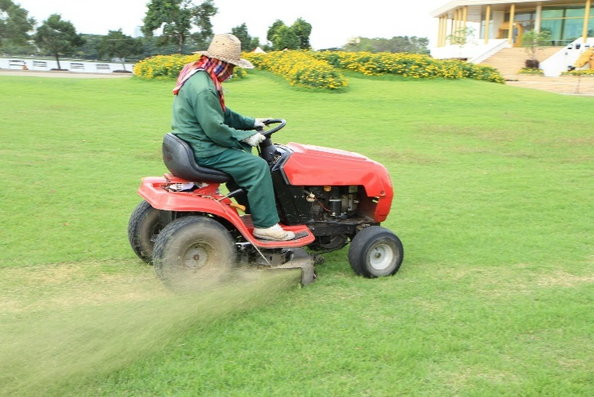
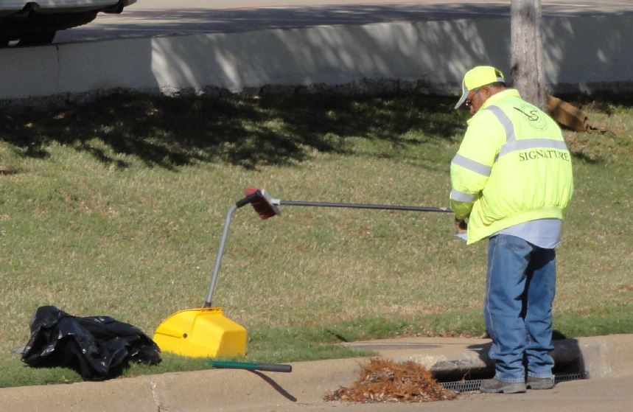
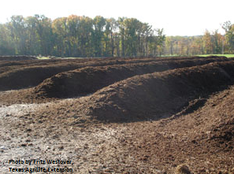
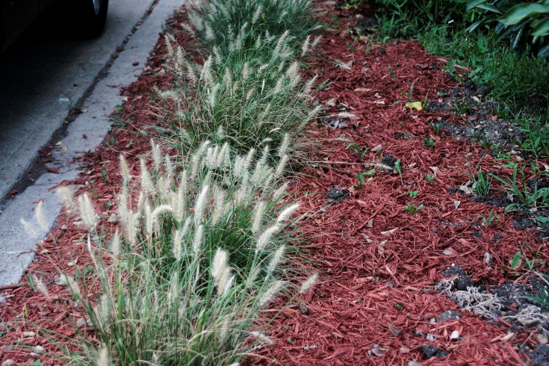
DO YOUR PART—KEEP POLLUTION OUT OF STORM DRAINS & WATERWAYS
PARKS & GROUND MAINTENANCE: SOIL & DEBRIS MANAGEMENT
Clippings
& Trimmings
Storm Drain Inlets
Compost &
Mulch
Soil Management
Mow grass as high as possible. Leave clippings on the lawn, out of roadways.
Sweep or blow clippings and trimmings onto the grass—or compost them.
Remove litter and debris from inlets.
Gather clippings and other debris, and dispose of them properly—not down the storm drain.
Use compost as a soil amendment, or shred leaves and add to flower beds as mulch.
Limit soil erosion.
—For bare areas, plant vegetation.
—For landscaped areas,
use mulch or matting.
report pollution & illegal dumping
[City Logo]
Be our eyes—look for and report signs of water pollution.
Signs include odor, an oily sheen on the water’s surface, colored or cloudy water, dead or dying fish, and excess trash.
Report spills and issues to [Contact Department, Phone Number].
Created in partnership with the Regional Stormwater Management Program.

Slide 7
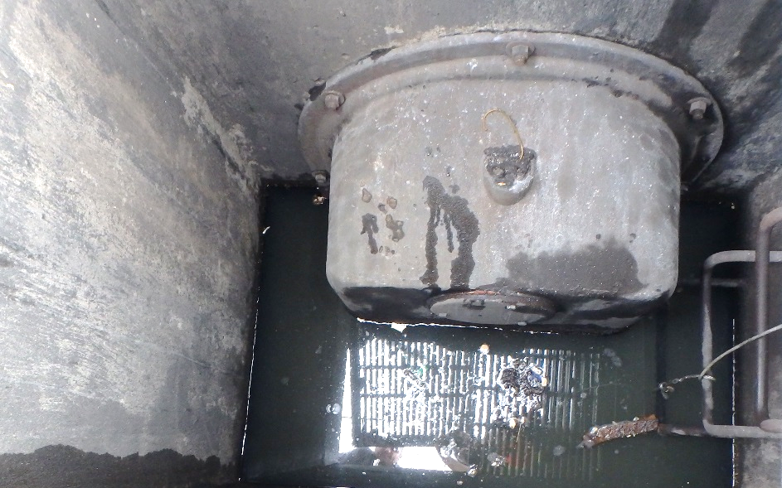
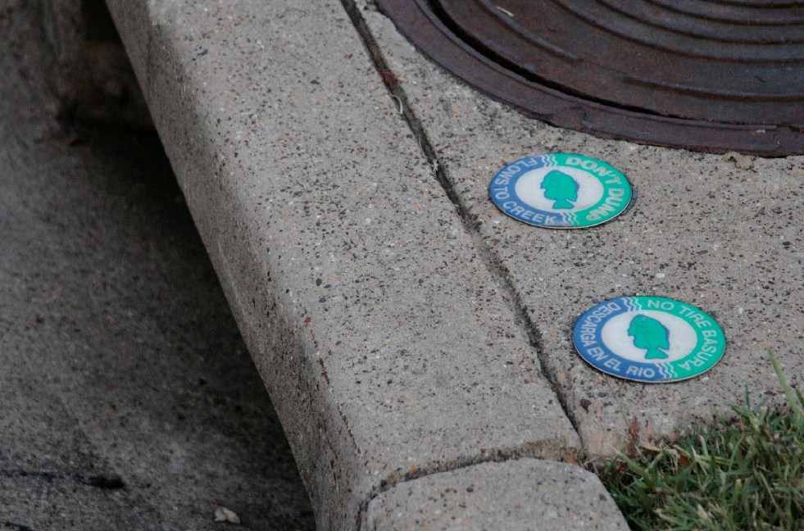
DO YOUR PART—KEEP POLLUTION OUT OF STORM DRAINS & WATERWAYS
Drainage Maintenance: Inlets, Catch Basins
Inlets & Structural
Controls
Litter & Debris
Removal
Storm Drain
Markers
Maintain and inspect inlets and structural controls as required.
Properly dispose of litter and debris removed from inlets.
Apply storm drain markers to inlets that show evidence of dumping.
REPORT POLLUTION & ILLEGAL DUMPING
[City Logo]
Be our eyes—look for and report signs of water pollution.
Signs include odor, an oily sheen on the water’s surface, colored or cloudy water, dead or dying fish, and excess trash.
Report spills and issues to [Contact Department, Phone Number].
Created in partnership with the Regional Stormwater Management Program.

Slide 8
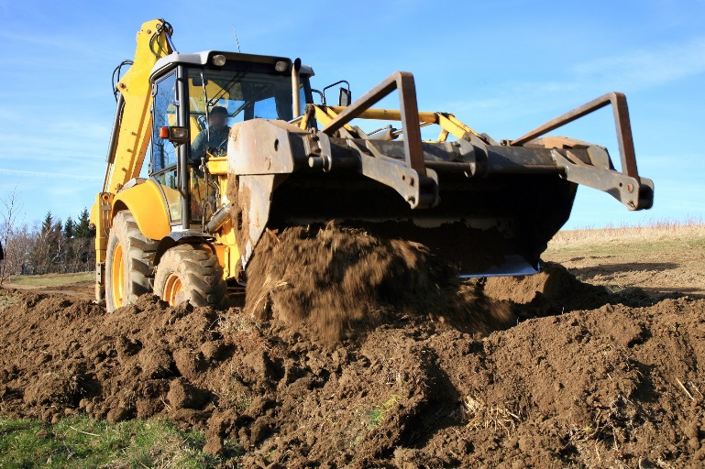
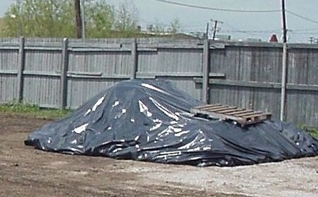
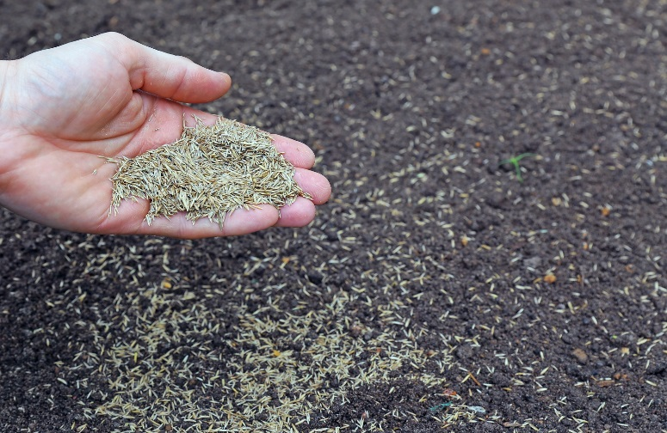
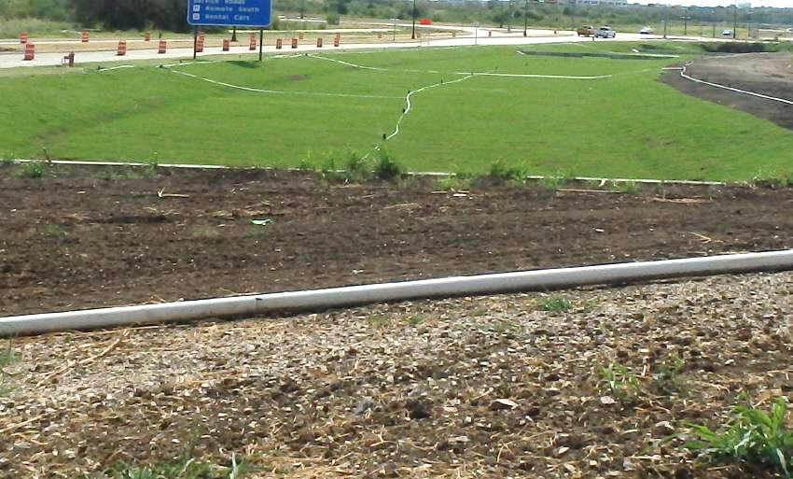
DO YOUR PART—KEEP POLLUTION OUT OF STORM DRAINS & WATERWAYS
Soil & Erosion Control
Recovered Soil
Stockpiles
Exposed Soils
Erosion & Sediment Control
Soil may be used on site as fill or stockpiled for another land application.
Locate stockpiles out of the street and away from flowing water or runoff.
Capture sediment using appropriate methods.
Cover soil and sand stockpiles to prevent erosion.
Apply grass seed to prevent erosion.
Protect channels by using turf reinforcement mats until vegetation is established.
Use erosion control methods such as erosion control blankets, vegetation, or mulching.
Use sediment control methods such as mulch berms.
report pollution & illegal dumping
[City Logo]
Be our eyes—look for and report signs of water pollution.
Signs include odor, an oily sheen on the water’s surface, colored or cloudy water, dead or dying fish, and excess trash.
Report spills and issues to [Contact Department, Phone Number].
Created in partnership with the Regional Stormwater Management Program.

Slide 9
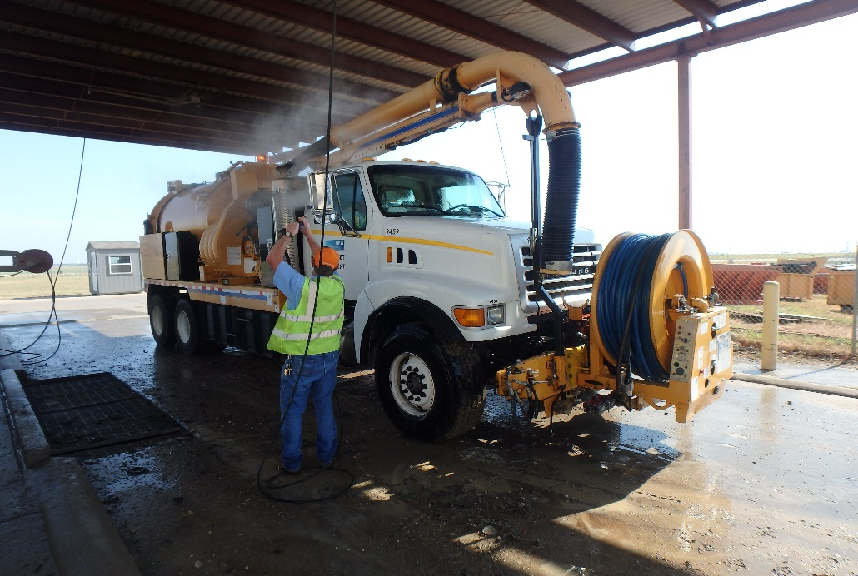
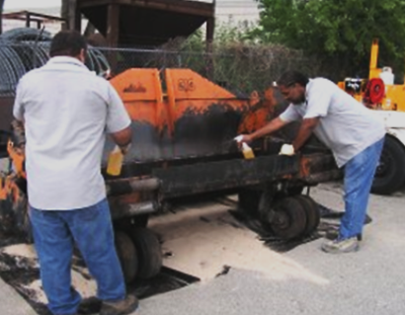
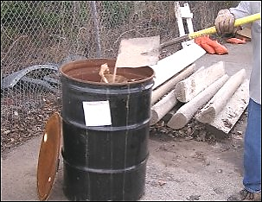
DO YOUR PART—KEEP POLLUTION OUT OF STORM DRAINS & WATERWAYS
streets maintenance: cleanup
Trucks, Equipment,
& Tools
Cleaning Equipment
Outdoors
Absorbent Cleanup
Clean trucks, equipment, and tools in designated wash facilities.
When wash facilities are not available, clean equipment over catch trays or absorbents spread on an impervious surface.
Promptly sweep up spent absorbents and dispose of them according to established procedures.
REPORT POLLUTION & ILLEGAL DUMPING
[City Logo]
Be our eyes—look for and report signs of water pollution.
Signs include odor, an oily sheen on the water’s surface, colored or cloudy water, dead or dying fish, and excess trash.
Report spills and issues to [Contact Department, Phone Number].
Created in partnership with the Regional Stormwater Management Program.

Slide 10
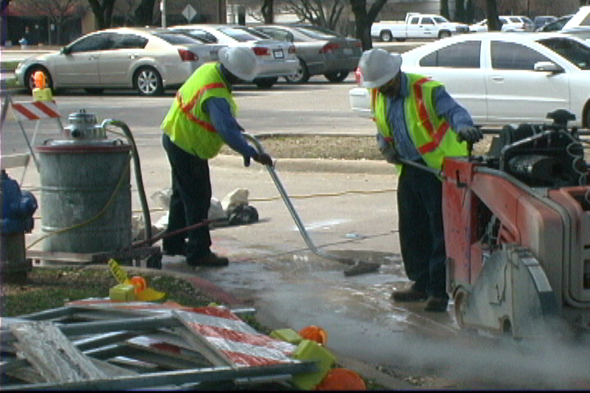
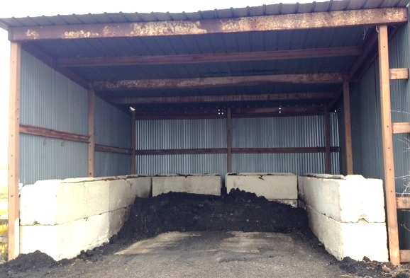
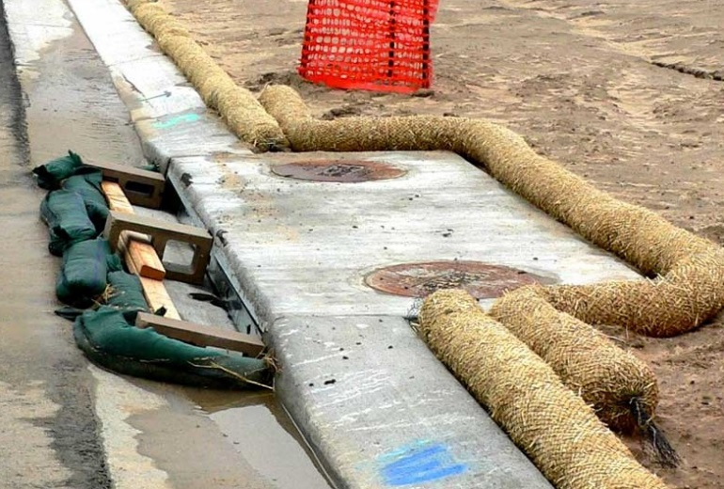
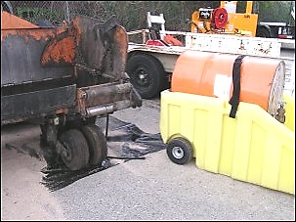
DO YOUR PART—KEEP POLLUTION OUT OF STORM DRAINS & WATERWAYS
streets maintenance: pavement repair
Saw-Cutting
Operations
Asphalt Stockpiles
Stormwater
Protection
Asphalt Patching
Vacuum slurry and cuttings while working.
Dispose of slurry according to established procedures.
Locate stockpiles on a paved surface.
Cover the stockpiles to prevent contact with rain.
Protect inlets while working.
Use appropriate erosion and sediment control methods.
Inspect control methods as needed.
Mix only the necessary amount.
Use biodegradable products rather than diesel.
Sweep up and properly dispose of all spent material.
report pollution & illegal dumping
[City Logo]
Be our eyes—look for and report signs of water pollution.
Signs include odor, an oily sheen on the water’s surface, colored or cloudy water, dead or dying fish, and excess trash.
Report spills and issues to [Contact Department, Phone Number].
Created in partnership with the Regional Stormwater Management Program.

Slide 11
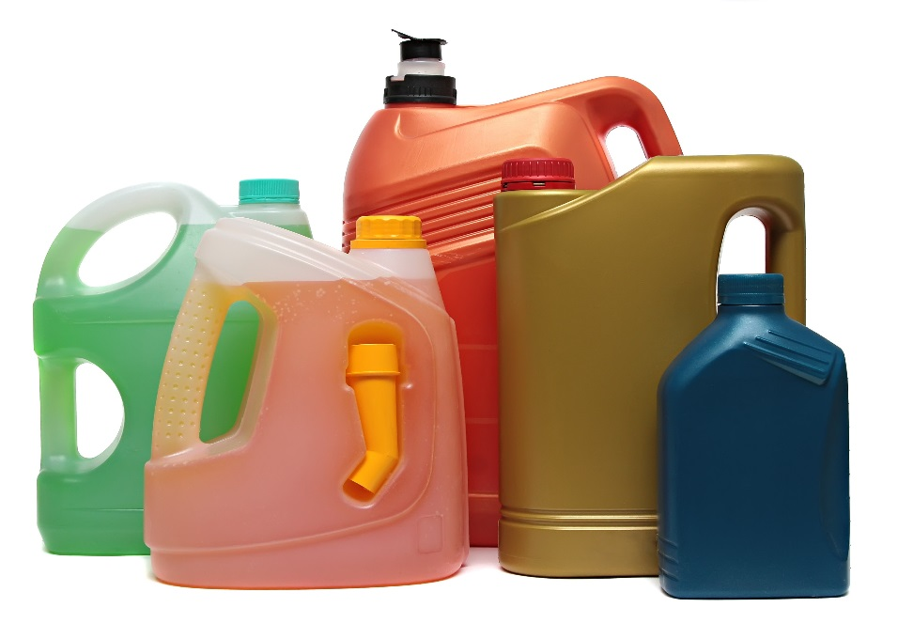
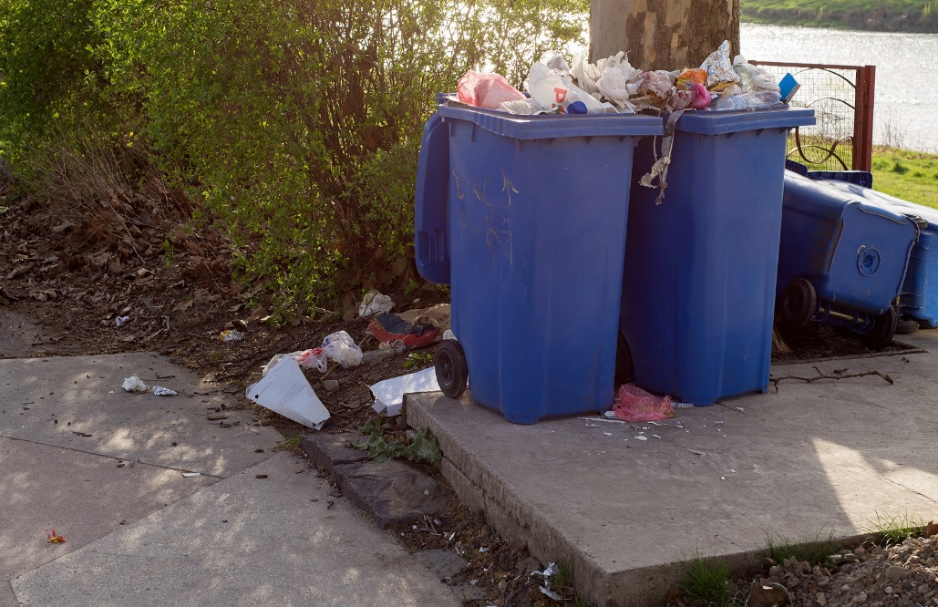
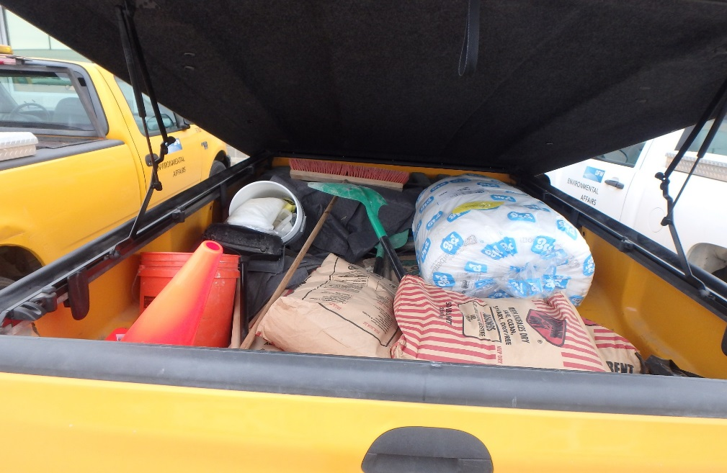
DO YOUR PART—KEEP POLLUTION OUT OF STORM DRAINS & WATERWAYS
Solid Waste Operations: Trash Collection
Liquid & Hazardous Waste
Litter Awareness
Spills
Do not pick up liquid waste, such as used motor oil, paint, antifreeze, cooling liquids, and cooking oil.
Do not pick up flammables, toxic waste, or explosives, such as used batteries, solvents and fuels, pesticides and fertilizers, fireworks and ammunition, fluorescent bulbs, and
pool chemicals.
Notify residents about household waste collection opportunities.
Notify residents of persistent problems with scattered trash.
Watch the area around the hopper and avoid leaving litter behind.
Pick up any trash that falls from the truck during compaction.
Cover open-topped trucks or roll-off containers with tarps.
Carry spill kits on collection trucks and service vehicles. Kits should include brooms, shovels, absorbents, pop-up pools, and gloves.
Clean up spills immediately.
REPORT POLLUTION & ILLEGAL DUMPING
[City Logo]
Be our eyes—look for and report signs of water pollution.
Signs include odor, an oily sheen on the water’s surface, colored or cloudy water, dead or dying fish, and excess trash.
Report spills and issues to [Contact Department, Phone Number].
Created in partnership with the Regional Stormwater Management Program.

Slide 12
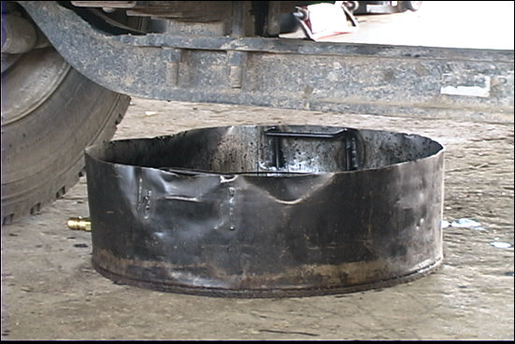
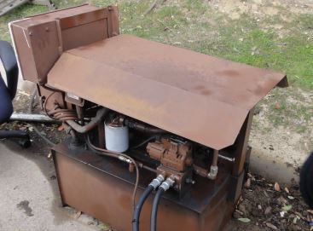
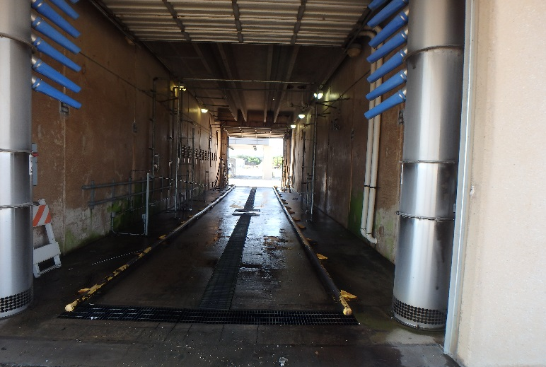
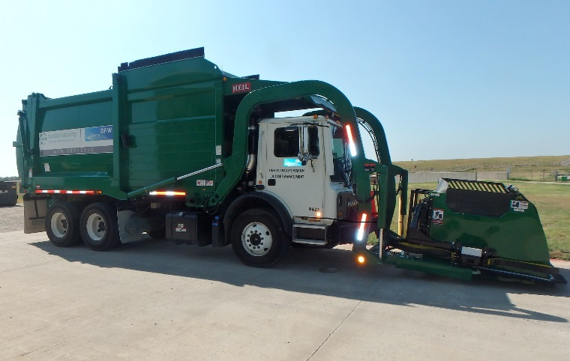
DO YOUR PART—KEEP POLLUTION OUT OF STORM DRAINS & WATERWAYS
solid waste vehicle operation
Leaks & Spills
Malfunctioning
Equipment
Washing Vehicles
Hopper Drain
Check vehicles frequently for leaking fluids. Notify supervisors of major leaks.
If a major leak occurs, take steps to stop the leak if possible. Contain the leak using absorbents.
Immediately clean up spills.
Report any malfunctioning equipment to supervisors.
Wash collection trucks only in facilities where wash water either drains to the sanitary sewer system or is collected and recycled.
Make sure that hopper drain plugs are always sealed during collection.
report pollution & illegal dumping
[City Logo]
Be our eyes—look for and report signs of water pollution.
Signs include odor, an oily sheen on the water’s surface, colored or cloudy water, dead or dying fish, and excess trash.
Report spills and issues to [Contact Department, Phone Number].
Created in partnership with the Regional Stormwater Management Program.

Slide 13
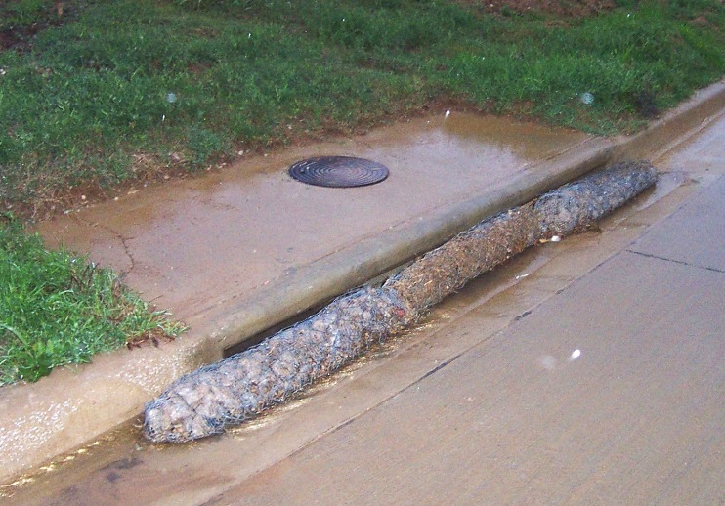
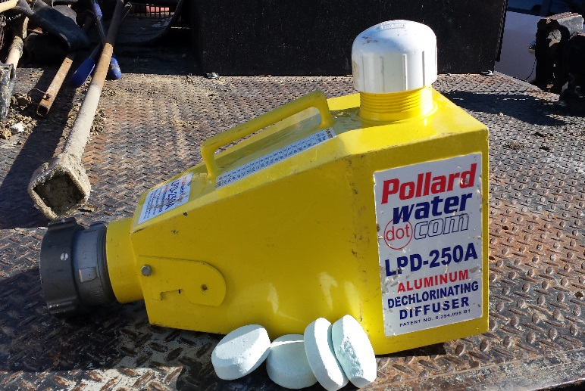
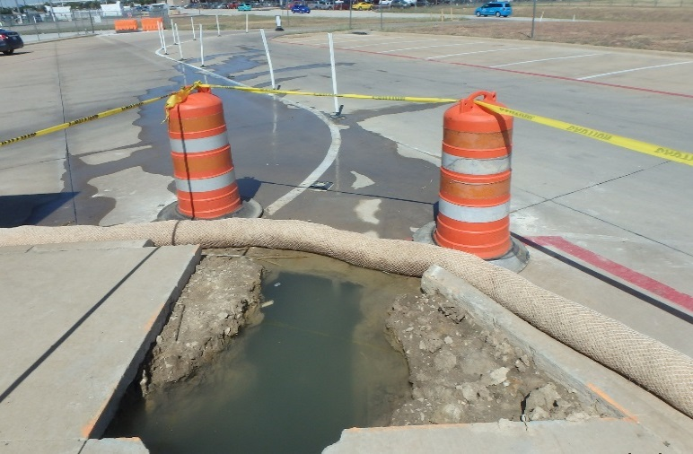
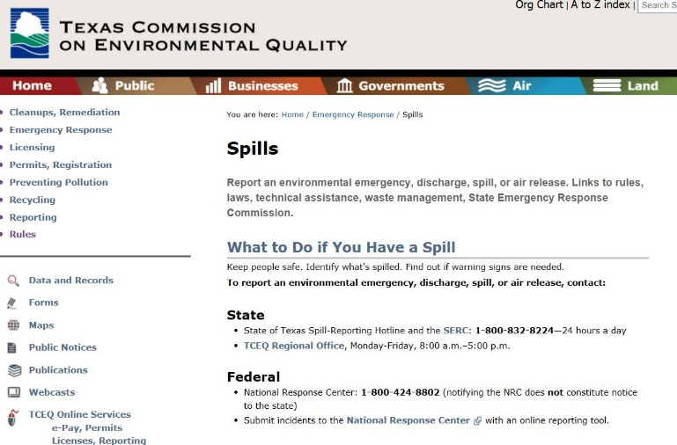
DO YOUR PART—KEEP POLLUTION OUT OF STORM DRAINS & WATERWAYS
water main repair / dewatering
Stormwater
Protection
Dechlorination
Cleanup
Reporting
Protect inlets while dewatering for sediment removal.
Use appropriate erosion and sediment control methods.
Potable water releases must be dechlorinated.
At the end of the discharge event, dechlorination agents must be removed.
Clean up sediment from
the street and inlet protection.
Use a street sweeper if needed.
Do not wash sediments down the storm drain.
Report spills, accidental discharges, and fish kills to supervisors immediately.
Supervisors will report appropriate spills to TCEQ within 24 hours, and will report fish kills to TCEQ and TPWD immediately.
report pollution & illegal dumping
[City Logo]
Be our eyes—look for and report signs of water pollution.
Signs include odor, an oily sheen on the water’s surface, colored or cloudy water, dead or dying fish, and excess trash.
Report spills and issues to [Contact Department, Phone Number].
Created in partnership with the Regional Stormwater Management Program.

