Slide 1
NCTCOG Recovery Summit and
Tabletop Exercise
January 15, 2020

Slide 2

Welcome and Introductions
Preston Cook, Lead Facilitator, IEM

Slide 3
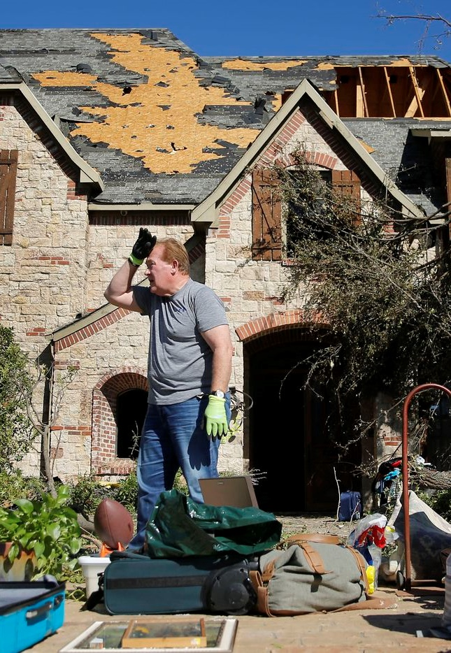
PURPOSE
Validate NCTCOG Recovery Framework by assessing capabilities of North Central Texas jurisdictions and regional stakeholders to recover from a tornado outbreak affecting the region.
Notes:
The purpose of this TTX is to validate the NCTCOG Recovery Framework by assessing the capabilities of North Central Texas jurisdictions and regional stakeholders to recover from a tornado outbreak affecting the region.

Slide 4
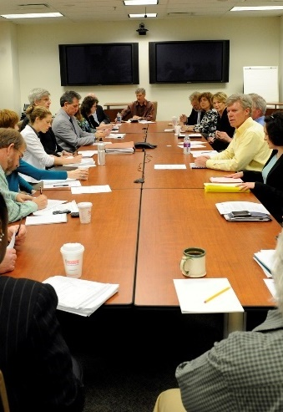
Focus on recovery roles, responsibilities, and actions of government and NGO partners
SCOPE
Three modules
Notes:
This TTX focuses on regional recovery from a tornado outbreak, specifically emphasizing roles, responsibilities, and expected actions by North Central Texas jurisdictions and stakeholder agencies.
Each segment of exercise play will continue until the Exercise Director determines that exercise objectives have been accomplished.

Slide 5

CORE CAPABILITIES
Housing
Infrastructure
Systems
Health and Social Services
Community Recovery`
Natural and Cultural Resources
Economic
Operational
Coordination
Planning
Public
Information
and Warning
Notes:
Capabilities-based planning
Steered by National Planning Scenarios and National Preparedness Priorities
Focus on planning under uncertainty
All-hazards approach to planning and preparation
Build upon existing capabilities of organizations that can be applied to a wide variety of event scenarios
Jurisdictions compare current capabilities against the Core Capabilities list.
Identify gaps in current capabilities and focus efforts on developing priority tasks.
See Appendix A of SitMan for more information related to capabilities-based planning.

Slide 6
PARTICIPANTS
Players
  Respond to scenario based on current plans and policies, experience, or training
Observers
  Encouraged to gather ideas for further consideration
  May participate in hotwash at end of TTX
Notes:
Players
Respond to scenario based on authority and knowledge of procedures, current plans and policies, and insights derived from experience or training
Observers
Encouraged to gather ideas generated during the moderated discussion for further consideration
May participate in hotwash at end of TTX
Generally do not participate in moderated
See page 2 of SitMan for additional information on each capability

Slide 7
PARTICIPANTS
Lead Facilitator
  Provides scenario updates and resolves questions
  Moderates brief-back period
Floating Facilitators
  Provide clarification and guidance
Evaluators
  Observe and record player discussions
Notes:
Lead Facilitator
Provides scenario updates and resolves questions
Moderates brief back period following table discussions
Floating facilitators
Move among tables to provide clarification and guidance
Evaluators
Observe and record player discussions
See page 2 of SitMan for additional information on each capability

Slide 8
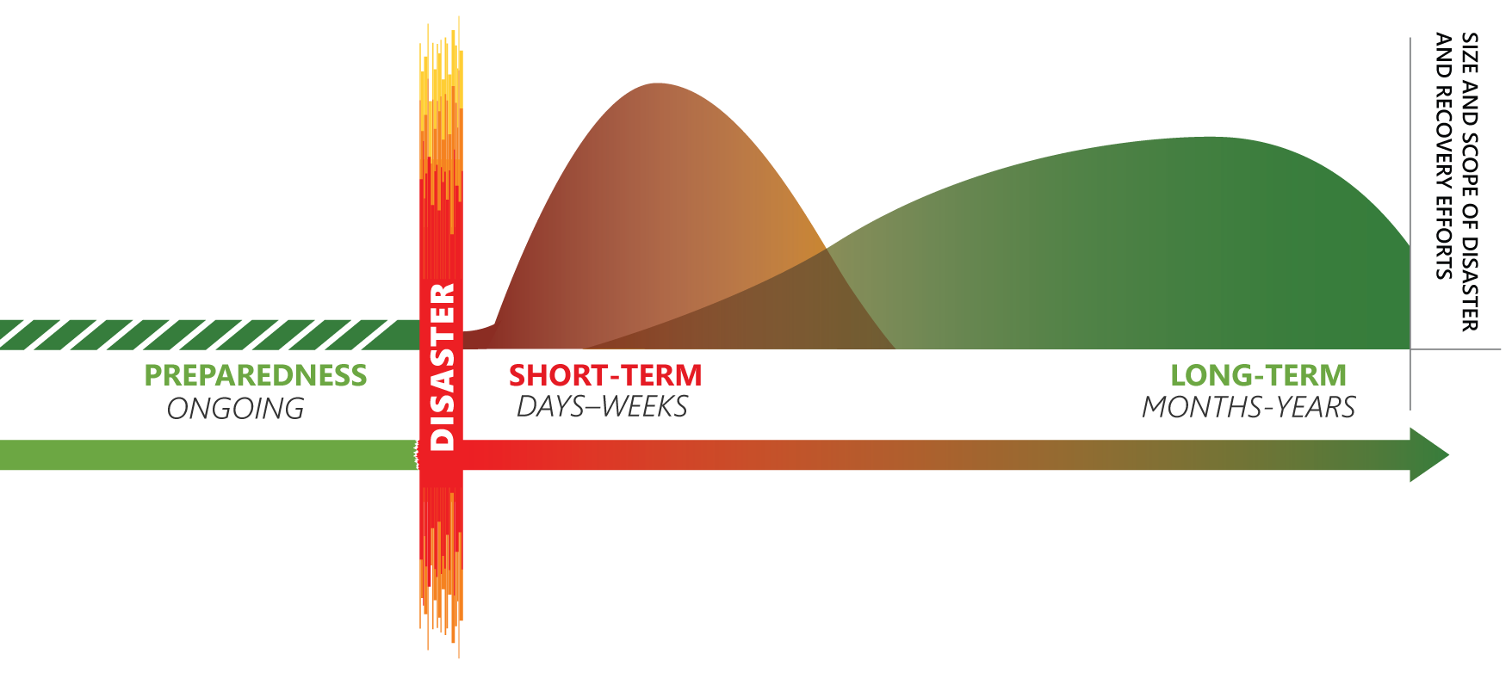
EXERCISE STRUCTURE
THREE MODULES: PHASES OF RECOVERY
Notes:
This will be a facilitated TTX with three modules
Module 1: Transition from Response to Recovery and Immediate Recovery Actions
Module 2: Short-term Recovery
Module 3: Long-term Recovery
See page 2 of SitMan for additional information on each capability

Slide 9
MODULE STRUCTURE
Module introduction
Table discussions
Brief back
Repeat
Notes:
Module introduction
Table discussions, using discussion questions as a guide
Moderated brief back
Repeat
See page 2 of SitMan for additional information on each capability

Slide 10
EXERCISE GUIDELINES
Open, low-stress, no-fault environment
Varying viewpoints
Respond based on knowledge of current capabilities or training
Decisions not precedent-setting
Discuss multiple options and solutions
Suggest actions that could improve efforts
Focus on problem-solving
Discussion questions are a guide—DO NOT need to answer all questions
Notes:
Open, low-stress, no-fault environment
Varying viewpoints, even disagreements, are expected
Respond based on knowledge of current plans and capabilities (i.e., use only existing assets) and insights derived from training
Decisions not precedent-setting, may not reflect final position
Discuss multiple options and solutions
Suggest actions that could improve efforts
Focus on problem-solving
Discussion questions are a guide
Tables DO NOT need to get through all of them
See page 3 of SitMan for additional information

Slide 11
ASSUMPTIONS AND ARTIFICIALITIES
The scenario is plausible
Events occur as presented
No hidden agendas or trick questions
All participants receive information at the same time
Notes:
See page 3 of SitMan for additional information

Slide 12
EXERCISE SCHEDULE
Time | Activity
12:15 p.m. | Module 1: Response to Recovery Transition and Immediate Recovery Actions
1:40 p.m. | Module 2: Short-term Recovery
2:50 p.m. | Module 3: Long-term Recovery
4:00 p.m. | Hot Wash
4:15 p.m. | Adjourn

Slide 13
Module 1: Response to Recovery Transition and Immediate Recovery Actions

Slide 14
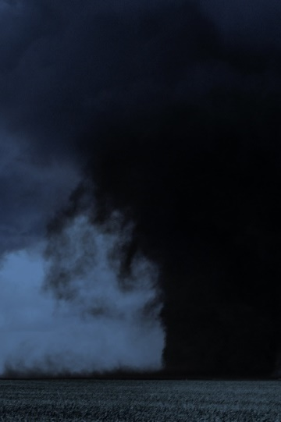
Friday, Jan. 10
12:30 A.M. 0 Hours
Rare tornado outbreak
Storm Prediction Center warned of possible severe weather
From midnight to 2 a.m., numerous counties received tornado warnings
Notes:
12:30 a.m. – 0 Hours
In the early morning hours of Friday, January 10, 2020, a rare tornado outbreak occurs across the North Central Texas region. Although January tornadoes are unusual, they are not unheard of in the area. Earlier in the day, the Storm Prediction Center warned of the possibility of a severe weather outbreak, and, from 12:00–2:00 a.m., numerous counties in the region received tornado warnings. Forecasters estimate 12 tornadoes touched down throughout the region, several of them most likely EF-3 or higher, although that will not be confirmed for several more hours when the National Weather Service can survey the damage. Additionally, the entire region is inundated with heavy rains for hours. Since the peak of the severe weather took place overnight, mass casualties and fatalities occurred. Responders have worked through the night, performing searches and rescues.

Slide 15
TORNADO PATHS

Slide 16
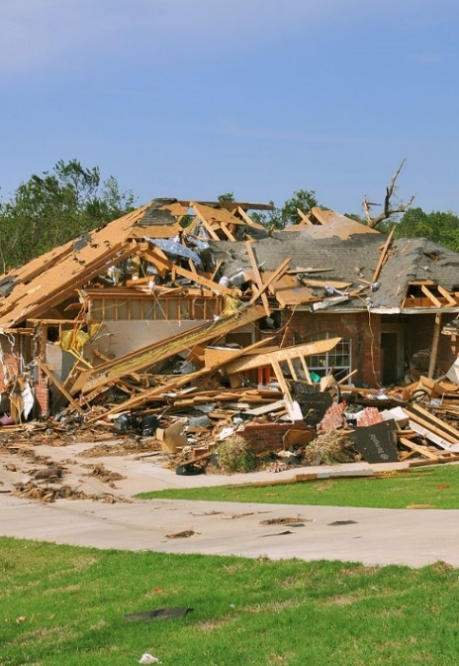
Friday, Jan. 10 7:00 A.M.
+6.5 Hours
As day breaks, damage becomes clear
Extensive damage throughout region
Ongoing localized flooding
Notes:
As day breaks, the extent of the damage becomes clear.

Slide 17
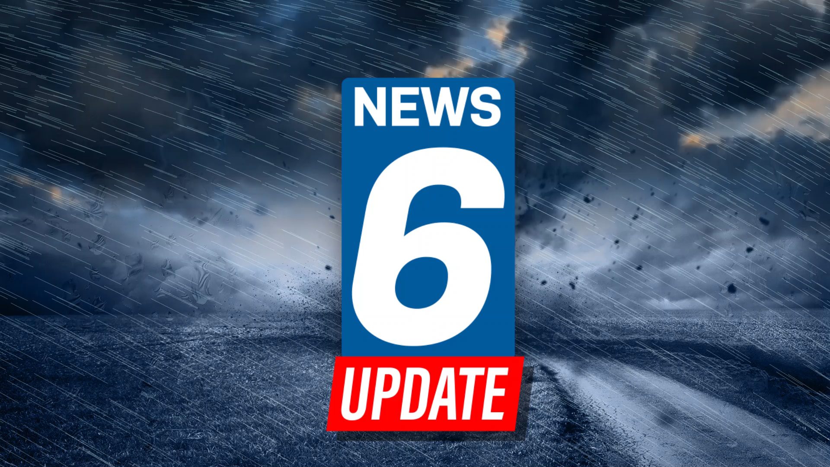
Notes:
Dramatic footage of damage from a series of storms that passed through north central Texas between midnight and 3 a.m. on Friday. The storms spawned an estimated 12 tornadoes, causing extensive damage to both commercial and dense residential areas. Three people have been reported to have died, with dozens more sustaining injuries.
The strongest of the tornadoes was estimated to be an EF-3, which is a tornado with winds of up to 140 miles per hour, strong enough to collapse the exterior walls of most buildings, uproot trees, and snap utility poles. Over 100,000 customers were initially without power in the Dallas/Fort Worth area alone.
Officials and survey teams are still in the early stages of assessment, but with the affected area being so large, it will take time for surveyors to get a complete picture of the damage, with costs expected to exceed $1 billion in damage.

Slide 18
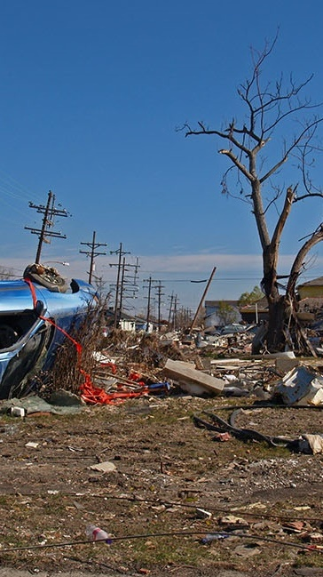
IMMEDIATE IMPACTS
10%–15% of housing is damaged
Significant infrastructure damage
40% without electricity
25% without water
Heavy debris
Historic sites heavily damaged
Hospitals, schools, and major highways affected
Notes:
Based on initial aerial surveys, officials estimate 10 percent to 15 percent of the housing in every county in the North Central Texas region is damaged. Significant damage has occurred to infrastructure throughout the region. Currently, 40 percent of the region does not have electricity, and 25 percent of households are without water. Heavy debris litters I-20 and I-35, other major highways, and smaller roadways. Several historical sites, including the Stockyards at Fort Worth, and Highland Park Village in Dallas have sustained heavy damage. Hospitals and schools throughout the region are damaged. Tree damage throughout the region is extensive, and localized flooding is ongoing due to heavy rain coupled with power failures.

Slide 19
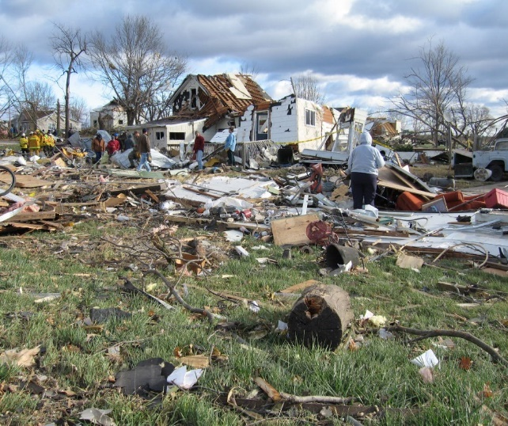
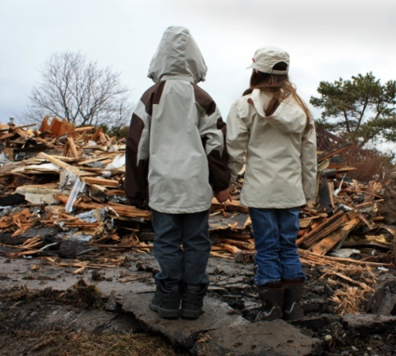
Friday, Jan 10
5:30 p.m. +17 Hours
All critical care patients rescued and transported
Hospitals overwhelmed with EMS
9-1-1 centers inundated with phone calls looking for loved ones
Hundreds arrive at hospitals searching for loved ones
Notes:
Officials indicate that all critical care patients have been rescued and transported. Hospitals are overwhelmed with EMS–transported victims and citizens transporting the injured in their personal vehicles. 911 centers continue to be inundated with phone calls from victims’ families and friends looking for information. Hundreds of people show up at hospitals desperately searching for their loved ones.

Slide 20
Wednesday, Jan 15
+5 Days
Life-saving measures—including searches and rescues and EMS operations—have been completed
Power has been restored to the majority of residents, but 10% of habitable structures still do not have power
Notes:
Five days have passed since the tornado outbreak, and life-saving measures including searches and rescues as well as EMS operations have been completed. Power has been restored to the majority of residents, although 10 percent of habitable structures still do not have power. Local officials have been working to conduct initial damage assessments in preparation for the arrival of state and federal agencies.

Slide 21
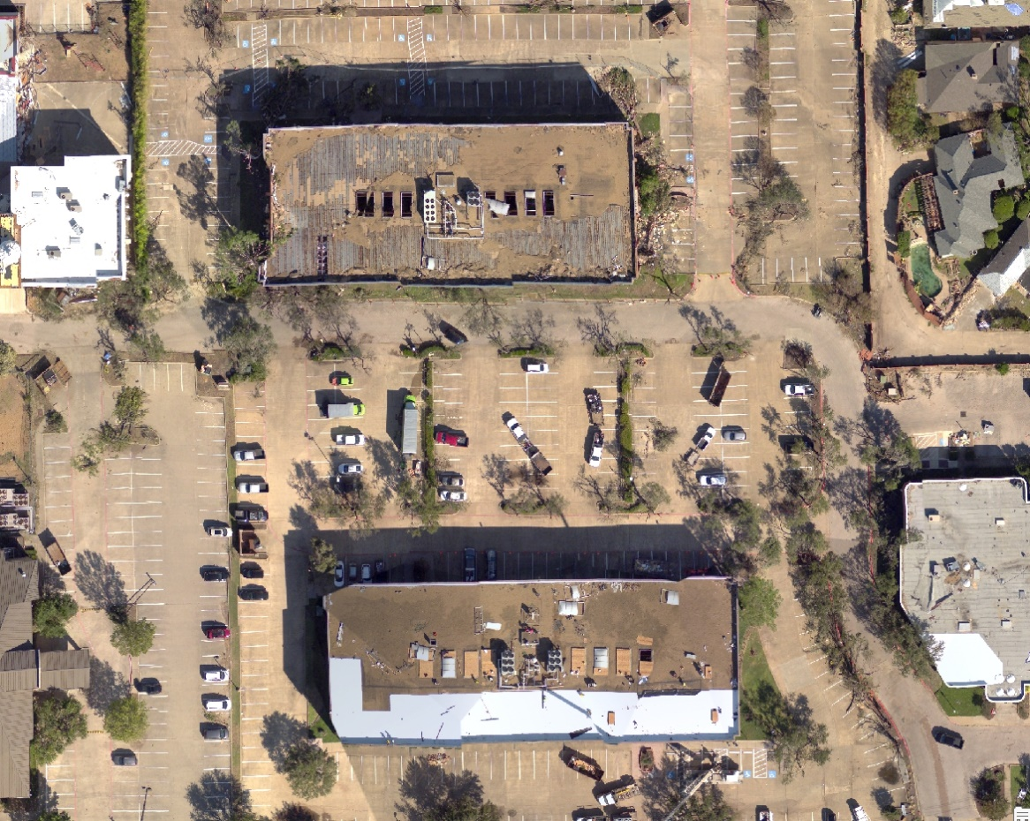
Wednesday, Jan 15
+5 Days
Local officials conduct initial damage assessments in preparation for arrival of state and federal agencies
Notes:
Five days have passed since the tornado outbreak, and life-saving measures including searches and rescues as well as EMS operations have been completed. Power has been restored to the majority of residents, although 10 percent of habitable structures still do not have power. Local officials have been working to conduct initial damage assessments in preparation for the arrival of state and federal agencies.

Slide 22

Table Discussions
Discussion questions on pages 6 through 8 of SitMan are a guide—no need to follow precisely or finish all of them
Choose a spokesperson who will provide a 5-minute brief-back to the larger group
The next module will then be introduced

Slide 23
Module 2: Short-term Recovery

Slide 24

February 10
+1 Month
Since Presidential declaration, local governments have been working closely with state and federal partners
Trash piling at curbs and dumpsters line streets
Contractors in short supply, hotels booked, and many residents still looking for interim housing
Notes:
Since receiving a Presidential declaration, local governments have been working closely with state and federal partners. In the weeks following the incident, the long list of recovery issues has become apparent. Homeowners have been clearing out homes and, every day, more and more trash piles up at curbs. Many homes are being repaired and renovated, and dumpsters line the streets. Contractors are in short supply, hotels are fully booked, and many residents are still looking for interim housing.

Slide 25
RECOVERY ISSUES
Conflicting information on insurance, homeowners assistance, and low-interest loans
Supply chain and infrastructure disruptions
Gas and cleaning supplies shortages
Unverified websites solicit donations and offer assistance to businesses and residents
Notes:
Multiple conflicting sources of information on insurance, homeowner assistance programs, and low-interest loans circulate on social media and within the community. Businesses are attempting to return to normal, but issues with supply chains and infrastructure disruptions are causing difficulties and slow recovery efforts. Due to structural damages, many of the region’s largest employers have suspended operations. Shortages persist for critical items like gas and cleaning supplies in some areas. Several spontaneous, unverified disaster-related websites appear, soliciting donations and offering assistance to businesses and residents. Dozens of schools are significantly damaged and are in the process of transitioning students to alternate locations.

Slide 26
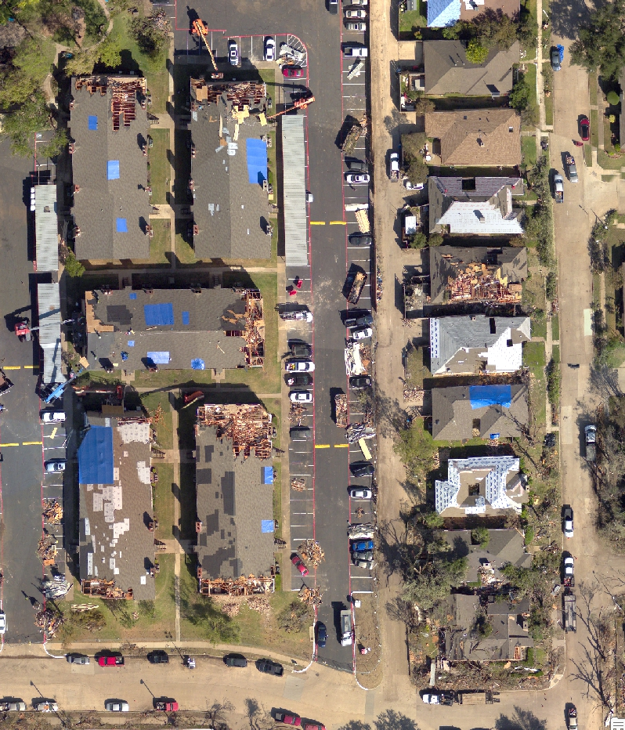
RECOVERY ISSUES
Dozens of significantly damaged schools transitioning students to alternate locations
Notes:
Multiple conflicting sources of information on insurance, homeowner assistance programs, and low-interest loans circulate on social media and within the community. Businesses are attempting to return to normal, but issues with supply chains and infrastructure disruptions are causing difficulties and slow recovery efforts. Due to structural damages, many of the region’s largest employers have suspended operations. Shortages persist for critical items like gas and cleaning supplies in some areas. Several spontaneous, unverified disaster-related websites appear, soliciting donations and offering assistance to businesses and residents. Dozens of schools are significantly damaged and are in the process of transitioning students to alternate locations.

Slide 27
Table Discussions
Discussion questions on pages 9 through 11 of SitMan are a guide—no need to follow precisely or finish all of them
Choose a spokesperson who will provide a 5-minute brief-back to the larger group
The next module will then be introduced

Slide 28
Module 3: Long-term Recovery

Slide 29
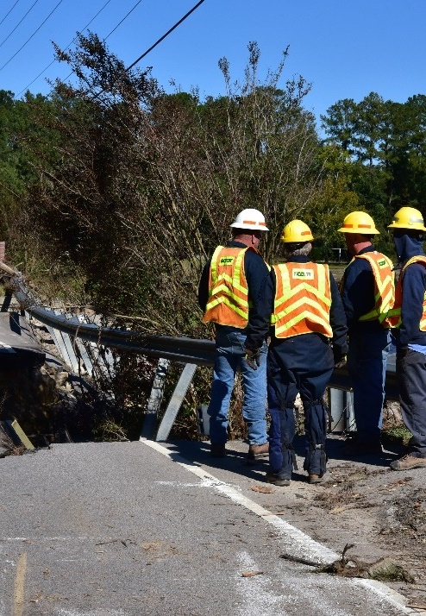
June 10
+6 Months
Most damaged infrastructure repaired
Homeowners who experienced significant damage fall short of paying for necessary repairs
Some residents have left the area to find work
Notes:
In the six months since the tornado outbreak, recovery efforts have progressed. Most damaged infrastructure has been repaired or is in the process of repairs. Residents have worked through their homeowner insurance claims, but many who experienced significant damage still fall short of paying for necessary repairs. Some residents have permanently moved out of the area to find work.

Slide 30

June 10 +6 Months
Rental rates skyrocket due to high demand and low supply
Increase in people experiencing homelessness
Many small businesses and restaurants have permanently closed
Frustrated residents criticize local officials on social media for “not doing enough” to support residents
Notes:
Due to high demand and low supply, rental rates have skyrocketed, and there is an increase in people experiencing homelessness. Many small businesses and restaurants have permanently closed. Frustrated residents have taken to social media to criticize local officials for “not doing enough” to support residents.

Slide 31
Table Discussions
Discussion questions on pages 12 through 14 of SitMan are a guide—no need to follow precisely or get through all of them
Choose a spokesperson who will provide a 5-minute brief-back to the larger group

Slide 32
Closing Discussion

Slide 33
CLOSING
Hotwash
Feedback
Next Steps
  After-Action Report/Improvement Plan (AAR/IP)
  Edits for North Central Texas Recovery Framework
  Impacts on other existing plans, policies, and procedures (if applicable)
Notes:
Hotwash. Conduct an immediate after-action discussion focusing on TTX objectives, decision making, and information coordination. This discussion will include closing comments from key agency representatives.
Identify next steps. Clearly identify follow-up actions to the exercise, including development of the after-action report/improvement plan, edits for the North Central Texas Recovery Framework, and impacts on other existing plans, policies, and procedures (if applicable).
Feedback. Complete and return participant feedback forms to exercise support staff.

