Slide 1
Public Education
Task Force
Wednesday, October 24, 2018
9:30 am, Fourth Floor Large Meeting Room

Slide 2
Agenda
Doo the Right Thing
Cooperative Purchase
March is Texas SmartScape Month
NCTCOG Updates
Roundtable

Slide 3
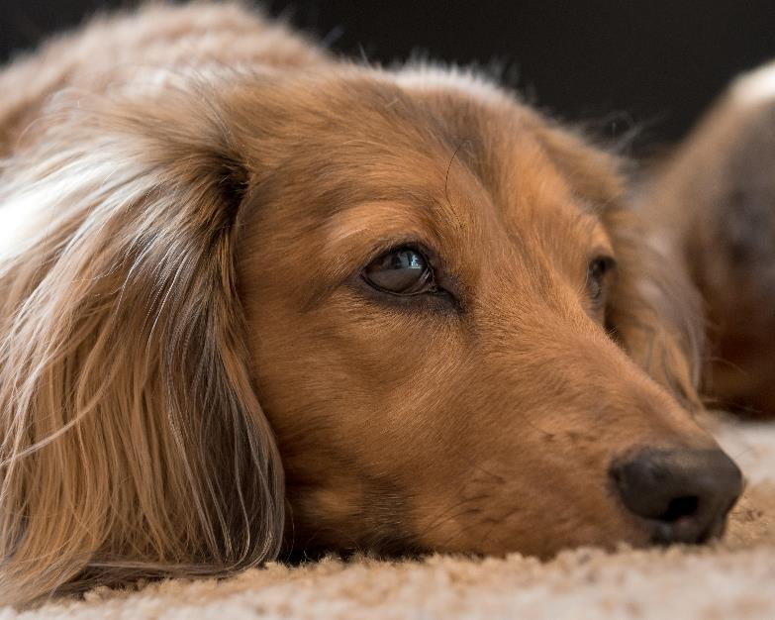
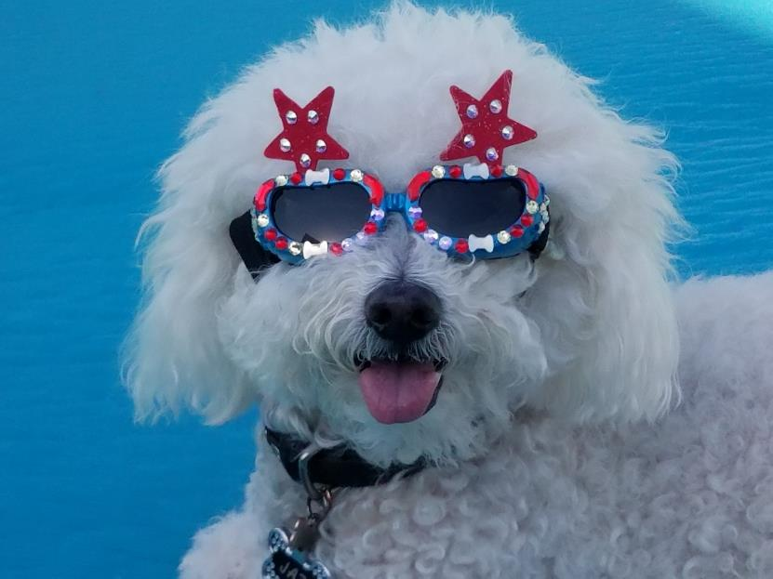
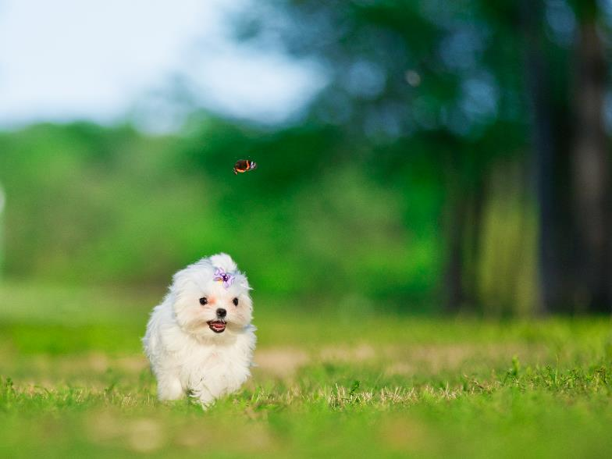
Doo the Right Thing
Final edits in process
  PDF and print file will be posted soon – look for links in follow-up email

Slide 4


FY19 Cooperative Purchase
Suggested Items:
  Curb Markers
    Plastic and Aluminum
    Adhesive
  Fat Trappers Containers and Bags
  Grease Lids
  Pan Scrapers
  Dog Waste Bag Dispensers and bag refills
Pick 1-5 of the following:
  Color changing cups
  Duck/Fish Gel Packs
  Dog Bandanas
  Recycled Tire Jar Opener
  Recycled Material Tote
Paper items (Bookmarks, Posters, Calendars, FOG Door Hangers, etc.) will not be included
  Printer-ready files are available by request at any time

Slide 5
FY19 Cooperative Purchase
Using past prices, we will have participants estimate how many of each item they would like to order
  Hopefully an online form for this
Procurement team at COG will go out to bid for items we need
  Having quantity estimates from above step will be helpful
Result will be similar to North Texas SHARE contracts
  Participants can use these contracts at any time to order any of these products with a guarantee that NCTCOG has already fulfilled legal procurement needs (as long as your city is not stricter than the state)
  Participants will be able to order directly from these vendors under the contracts – no need to involve COG as a middleman

Slide 6
March is Texas SmartScape Month
Vote on the theme for 2019:
  Save Water. Save Green.
  Go Green. Save Green.
  Native. Adapted. Attractive.
Notes:
On to other things we could be doing with that staff time (or the money spent on that staff time…)

Slide 7

Texas SmartScape

Slide 8
Other NCTCOG Updates
Roster Updates: be on the lookout for an email
TMDL
  Texas Stream Team Bullseye Assessment Training moved to February 16, 2019
iSWM
  Post-Construction Workshop (TBD)
RSWMCC
  November meeting postponed, next meeting in January (TBD)

Slide 9
Roundtable
What’s happening in your city?

Slide 10






Contact Connect
Mayra Lopez
Environment & Development Planner
North Central Texas Council of Governments
mlopez@nctcog.org
817.695.9360
Facebook.com/nctcogenv
@nctcogenv
Tamara Cook
Manager, Environment and Development
North Central Texas Council of Governments
tcook@nctcog.org
817.695.9221
nctcogenv
youtube.com/user/nctcoged
Kathleen Myers
Environment & Development Planner
North Central Texas Council of Governments
kmyers@nctcog.org
817.695.9107
EandD@nctcog.org
nctcog.org/envir

